Slide 1




SEO
Report

Slide 2

01.
About Company
02.
Initial Audit
03.
Keyword Research
04.
On-Page SEO Optimization Audit
05.
Content Strategy
06.
Off-Page SEO
07.
Conclusion

Slide 3


About Company
Adobe is a leading technology company that specializes in developing software for creativity and digital experiences
Their services include:
Creative Cloud
Design Software
Photography Software
Video & Audio Software
Document Cloud
Acrobat
Sign
Digital Marketing Services
Marketing Cloud
Analytics Cloud
Advertising Cloud
Commerce Cloud

Slide 4
Initial Audit
Current Performance:
Initial analysis suggests potential for improvement in size of images used and its layout
Mobile speed index is high due to the image load time - Mobile optimisation is required
Strengths:
Brand Authority: Adobe is a well-established brand with a strong online presence. This can give them a natural advantage in search engine rankings.
Global Presence: Adobe likely has a strong backlink profile with links from other websites around the world.
120 million monthly organic traffic - 20K for adobe india
Weekness:
No H1 and H2 tags are used in the website
mobile speed index is 2X web speed index due to image loading time

Slide 5
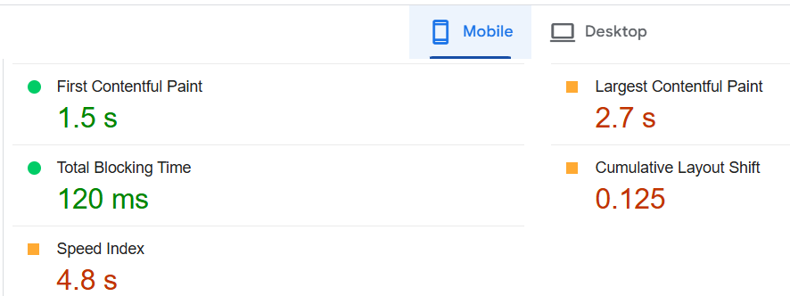
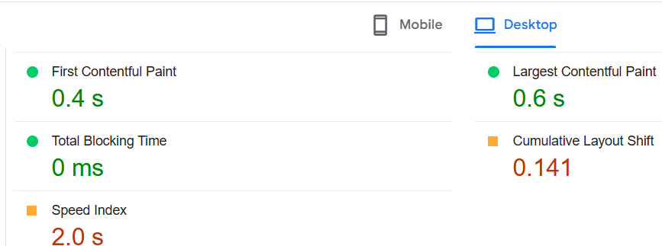
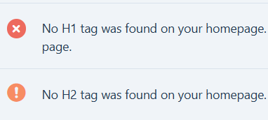
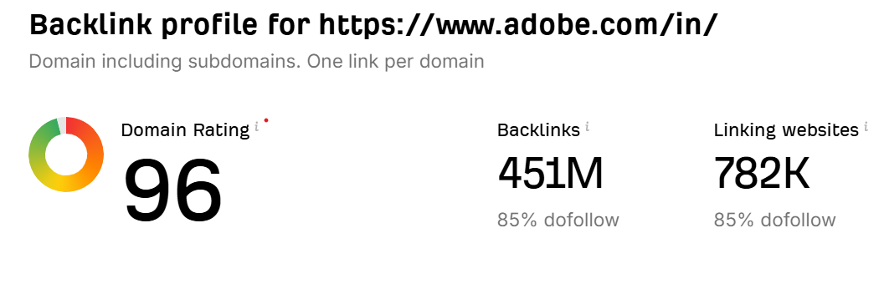
Tools used
PageSpeed Insights
RankMath
Ahrefs

Slide 6
Keyword Research
Primary Keywords
Adobe
Creative Cloud
Photoshop
Illustrator
InDesign
Premiere Pro
After Effects
Marketing Cloud
Document Cloud
PDF editor ( related)
Secondary Keywords
Photo editing software
Graphic design tools
Video editing software
Digital illustration
PDF editor
Stock images and graphics
Long-Tail Keywords
Best photo editing software
Free graphic design software
Video editing software for Windows
Marketing automation platform
PDF editor
Cloud-based design tools
AI-powered design tools
Competitor Analysis for Keywords
For Creative Cloud - The competitor rate is very high compared to other service provided by the Adobe.
Adobe's main competitors in keyword research include Canva for online design, Corel for vector and photo editing, Affinity for affordable design software, Sketch and Figma for UI/UX tools, Procreate for digital illustration

Slide 7
On-Page SEO Optimization Audit
Selected page : https://www.adobe.com/in/creativecloud.html
Strengths
Content Quality and Relevance
Title Tag and Description
Outgoing links - 195
Imagery
Weakness
Page optimization for mobile is required - speed is high
Keyword stuffing - few words are used more than 40 times
Actionable insights
Image optimization for mobile
Reduce keyword stuffing

Slide 8
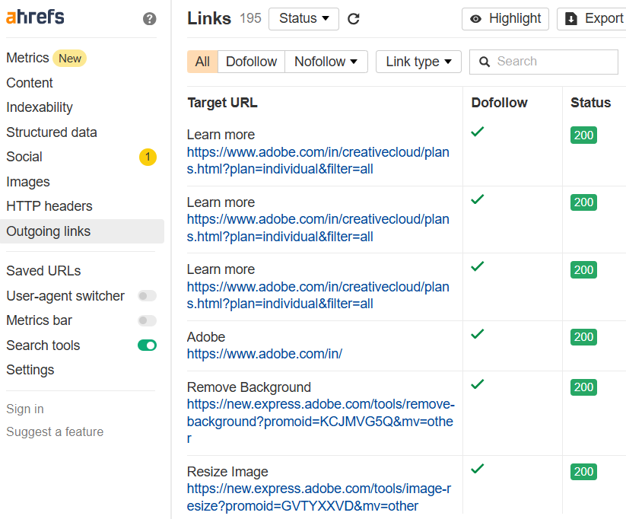
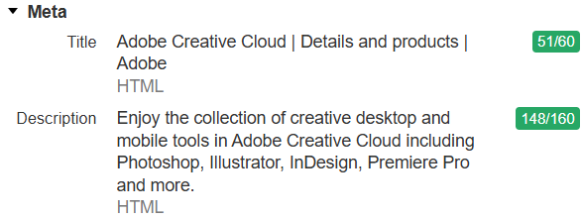
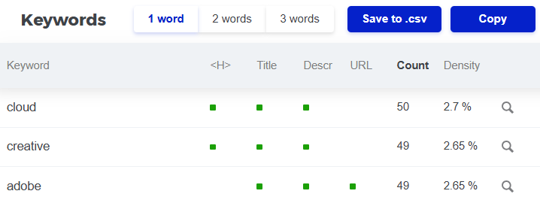
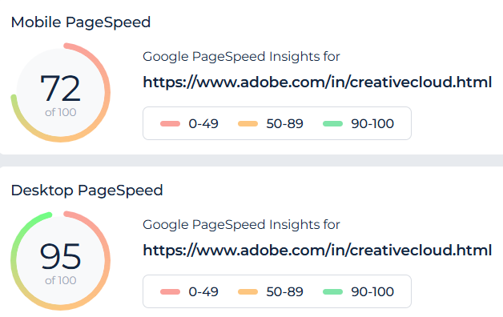
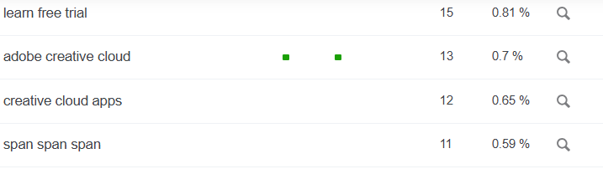
Tools used
Site Cheaker
Ahrefs

Slide 9
Content Strategy
Used Website : https://www.adobe.com/in/creativecloud.html
Content type: The website uses a mix of text, images, and videos to promote Creative Cloud.
The website emphasizes the benefits of subscribing to Creative Cloud, such as access to a wide range of apps, tutorials, fonts, templates, and cloud storage.
Call to action: The website includes a call to action to start a free trial of Creative Cloud.
Online Forums and Communities
Organic Reach

Slide 10
Off-Page SEO
High Quality Backlinks: Adobe courses , Youtube tutorials and Blog mentions about Adobe softwares by content creators
Branded searches: Adobe Products are highly regarded in the market regarding them ; Photoshop , Lightroom and adobe stock images are highly popular
High engagement and shares on social media platforms: Adobe encourages content creators by events and also collaborating with the content creators in socal media and during their software upgradation
Improvements
Local SEO: optimize the page for local search by including relevant keywords like "Creative Cloud India," "Best design software for India," etc.

Slide 11
Outcomes of this Project
This SEO audit report helped me to learn the required SEO audit tools
Keyword knowledge
Importance of high quality backlinks

